Slide 1
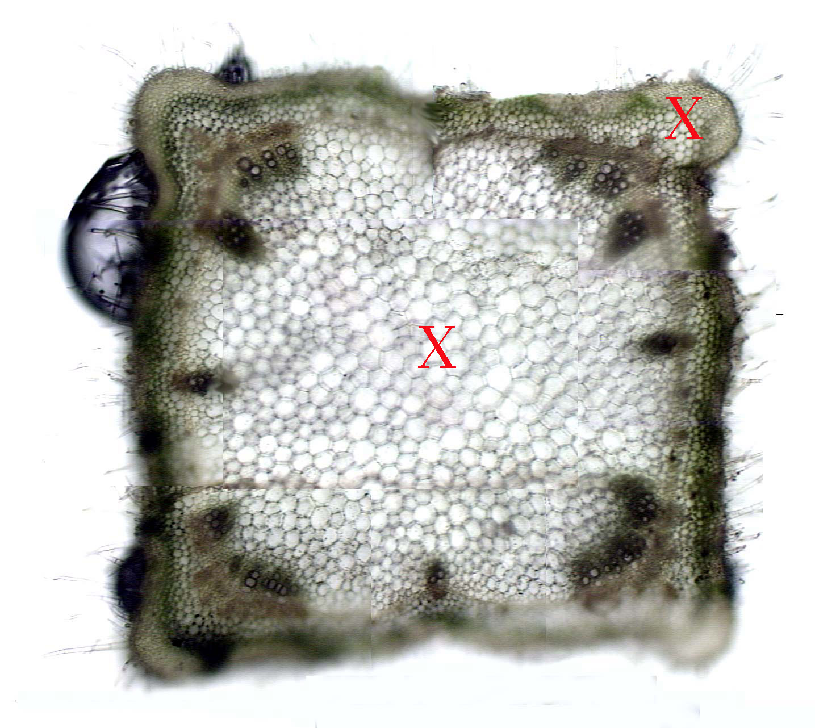
1. What is the Tissue system?

Slide 2
2. What is the Tissue system?

Slide 3
3. What is the Tissue system?

Slide 4
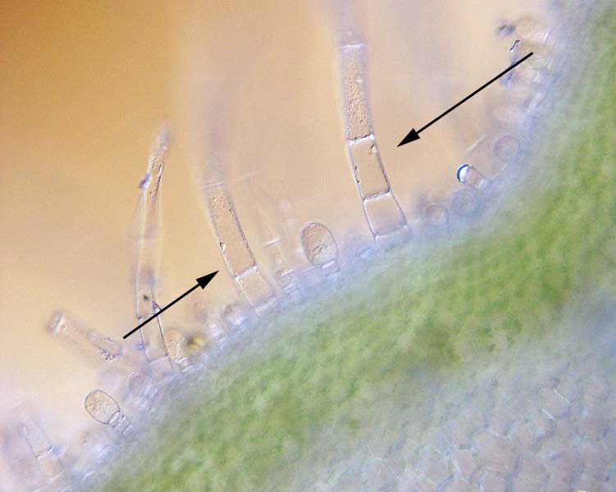
4. What are these structures?

Slide 5
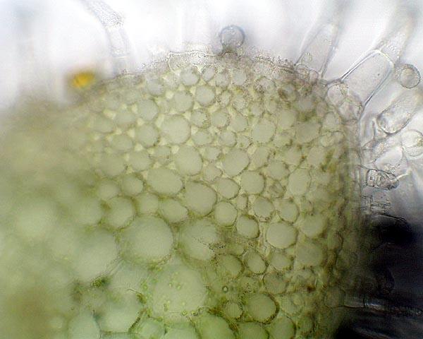
5. What is the Tissue ?

Slide 6
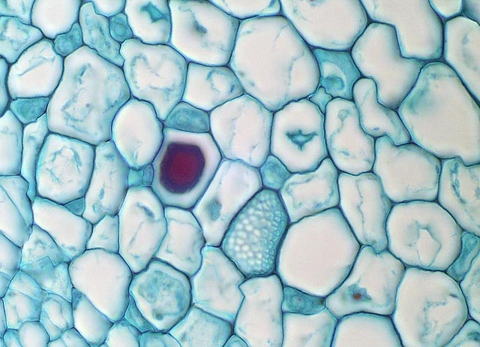
6. What is the Tissue?

Slide 7
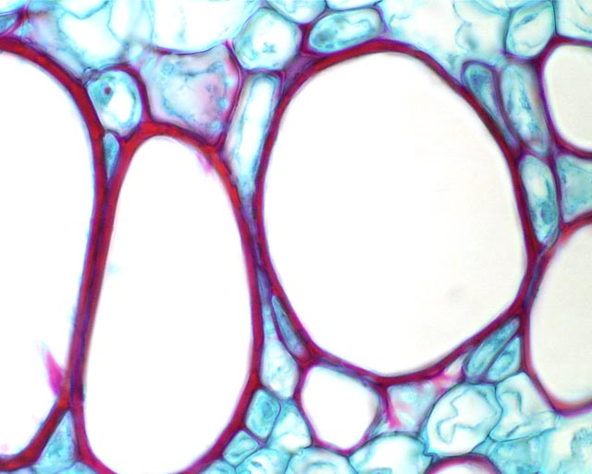
7. What is the Tissue?

Slide 8
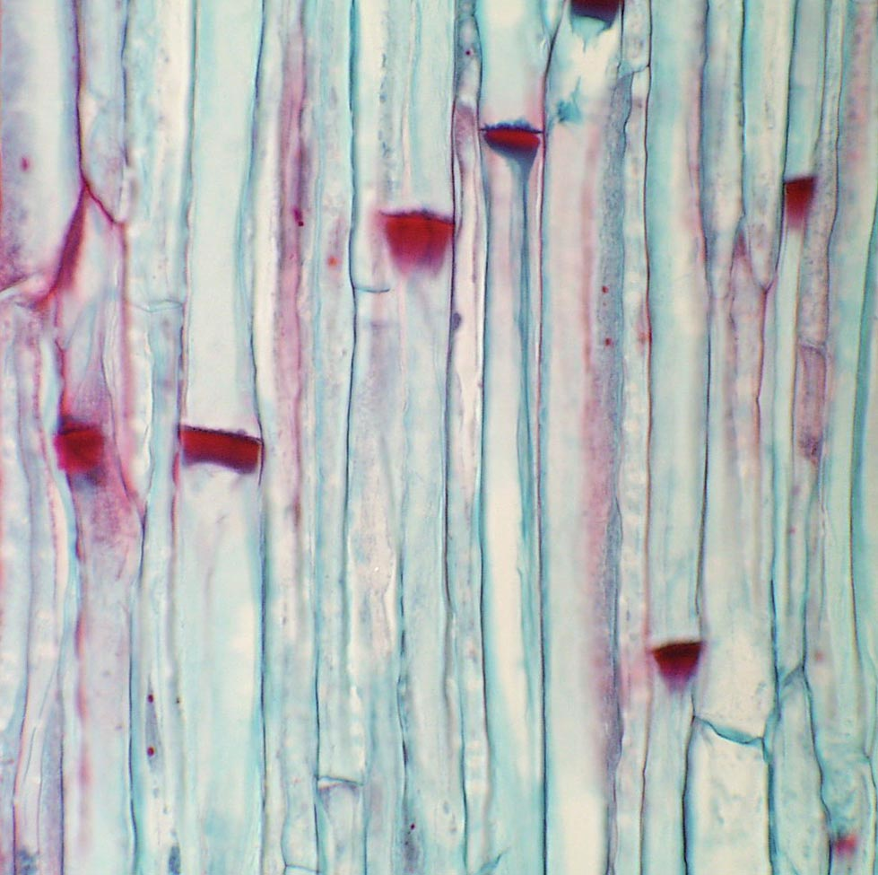
8. What is the Tissue ?

Slide 9
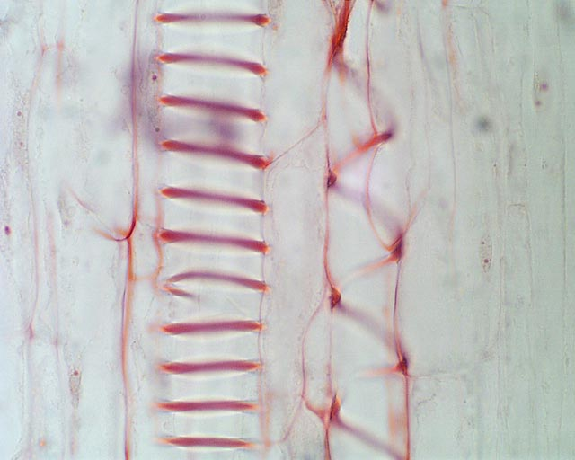
9. What is the Tissue?
….. How are the incomplete secondary walls adaptive?

Slide 10
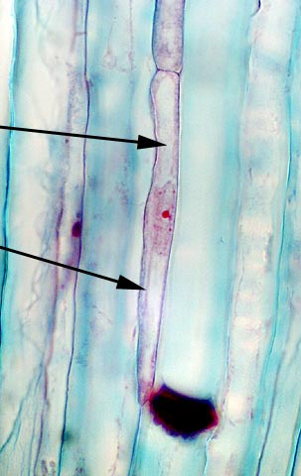
10. What type of cell is this?

Slide 11
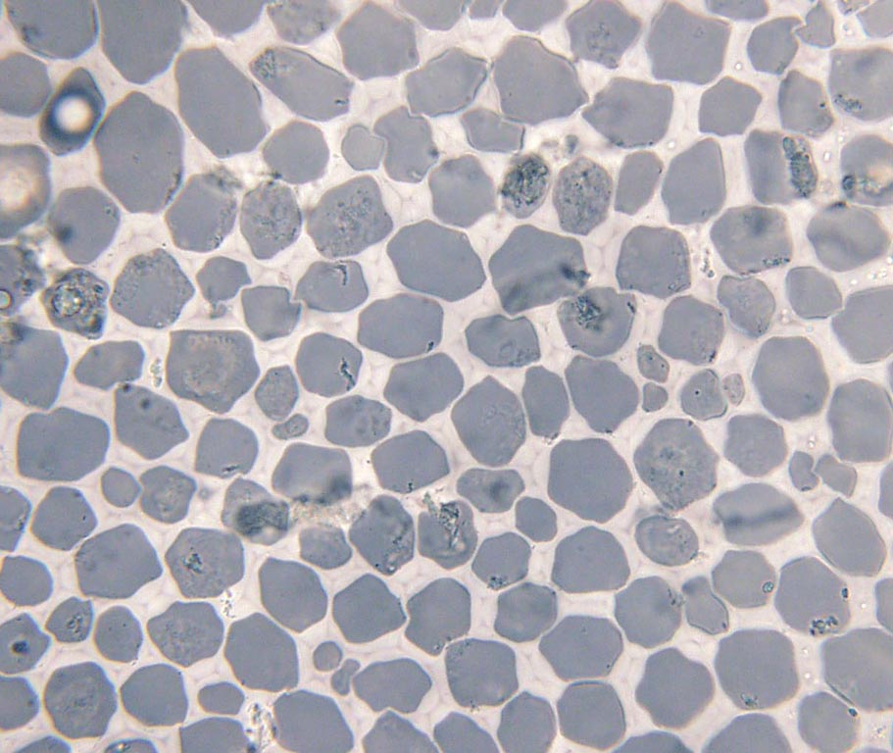
11. What is the Tissue?

Slide 12
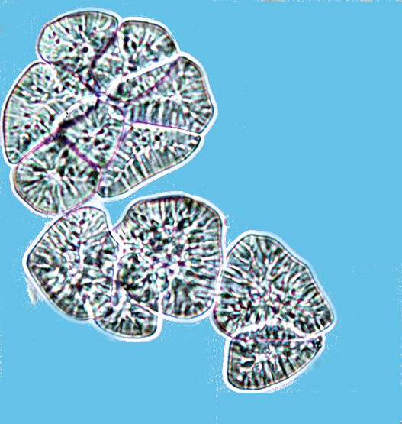
12. What type of cell is this?

Slide 13
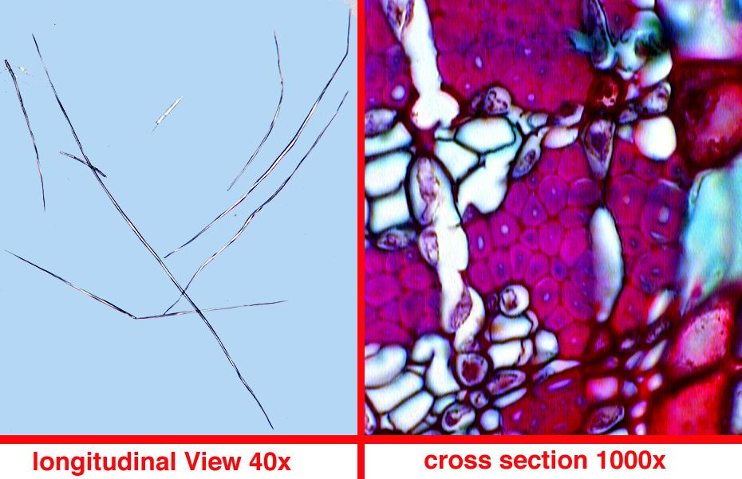
13. What type of cells are these?

Slide 14
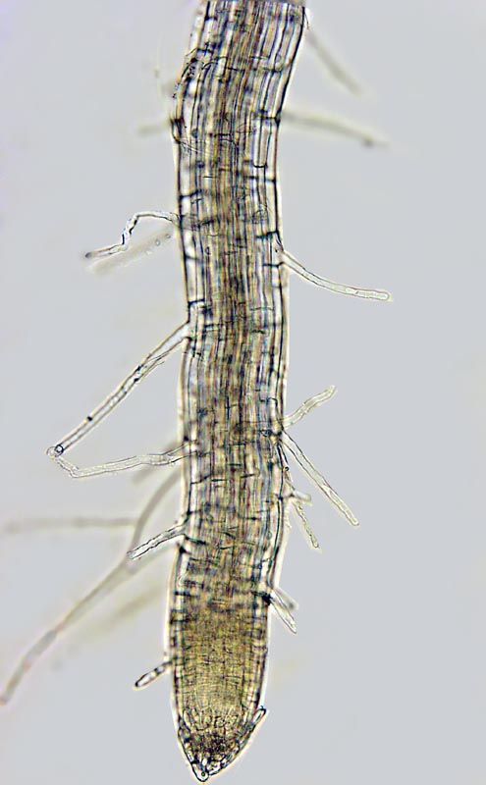
14. What is at the tip?
... What are the projections?

Slide 15
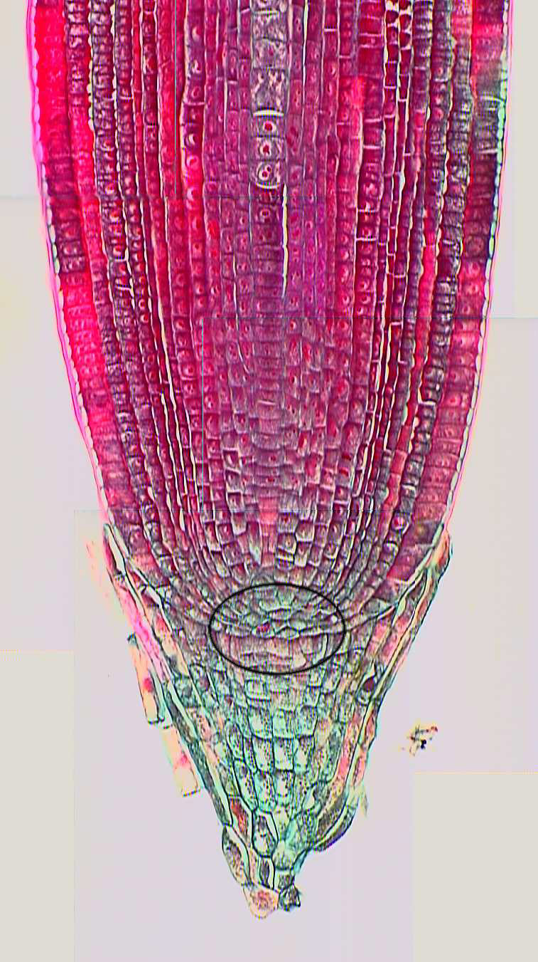
15. These cells make up the……..

Slide 16
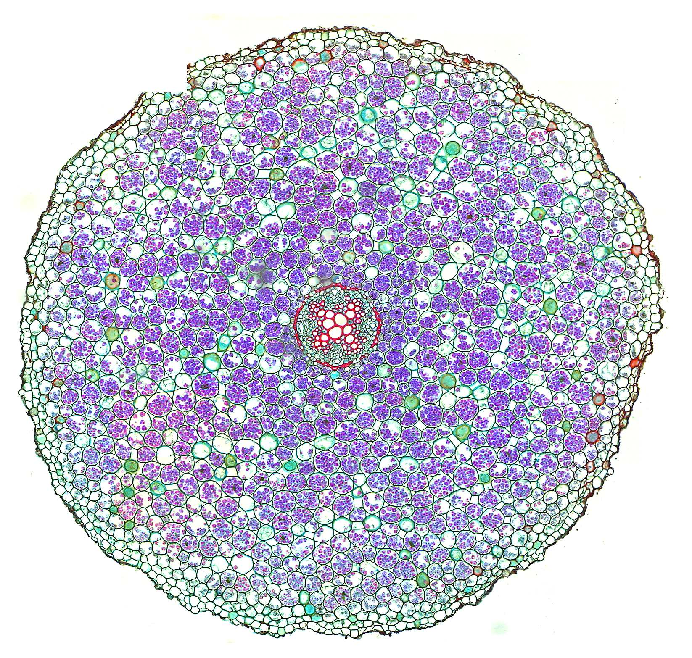
16. What is the tissue in the center?

Slide 17
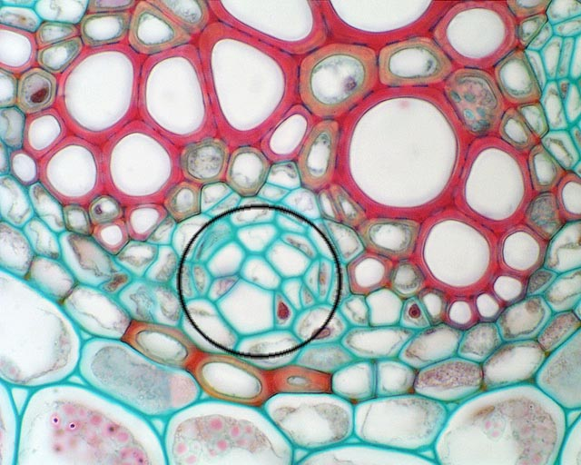
17a. What is the tissue?

Slide 18
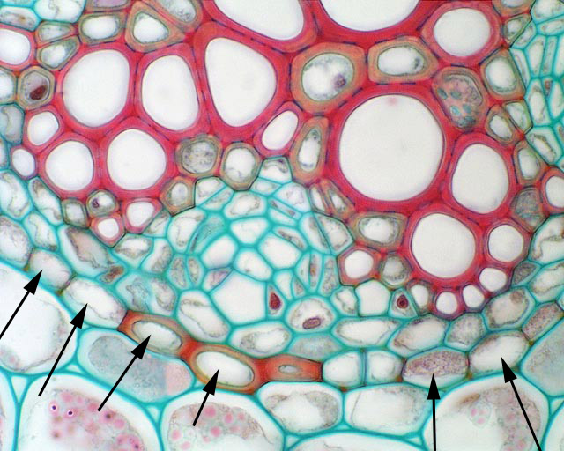
17b. These cells make up the…..

Slide 19
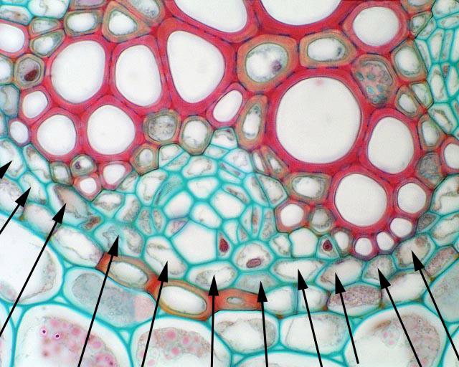
17c. These cells make up the……

Slide 20
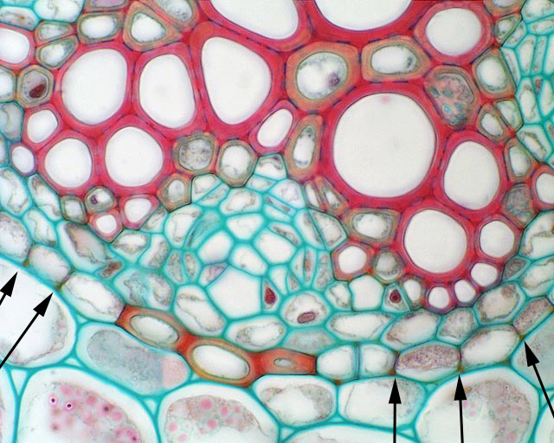
17d. What are these areas of the cell wall?

Slide 21
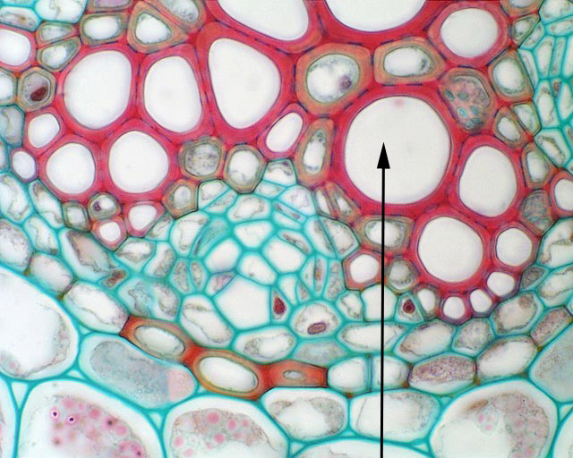
17e. What is this type of cell?

Slide 22
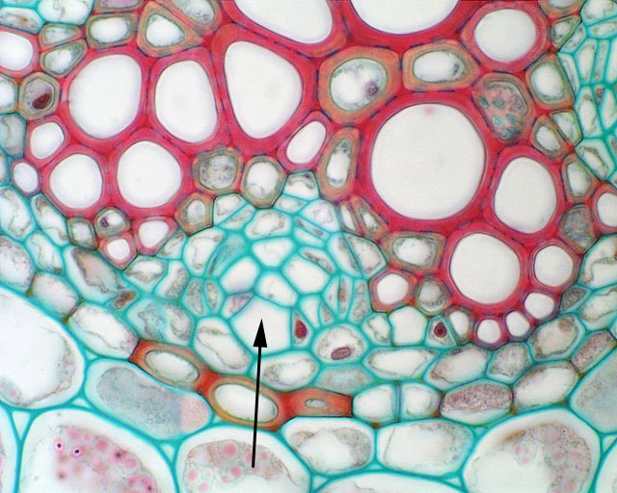
17f. What type of cell is this?

Slide 23
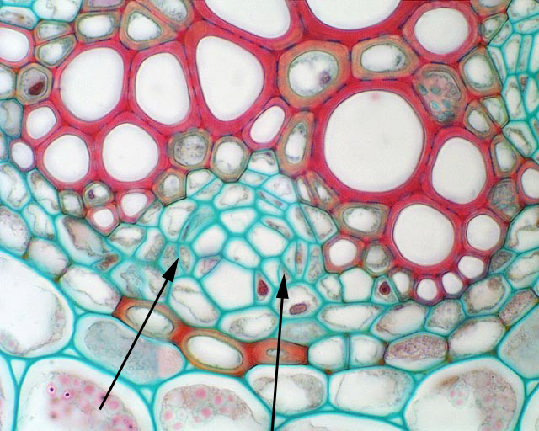
17g. In what way may water follow these paths?

Slide 24
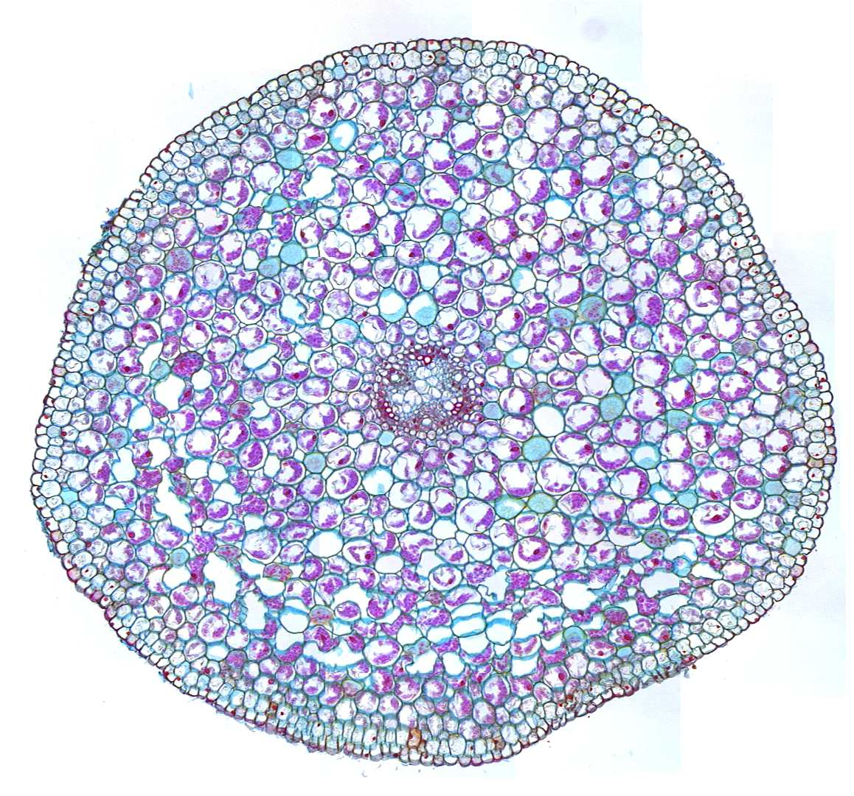
18. What is the tissue in the center?

Slide 25
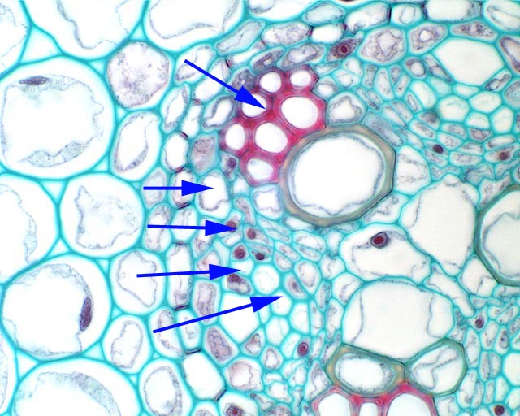
19a. In what way may water follow these paths?

Slide 26
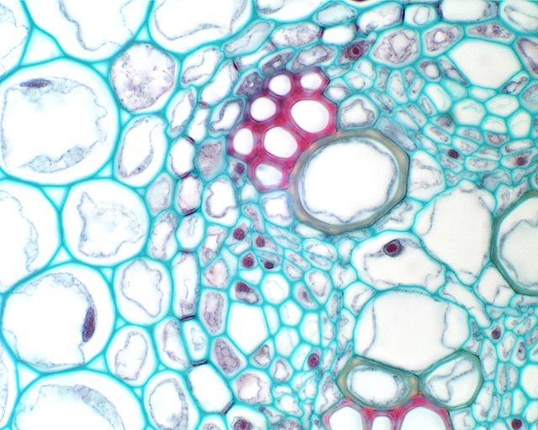
19b. Primary xylem differentiates: 1. from the inside out. 2. from the outside in.

Slide 27
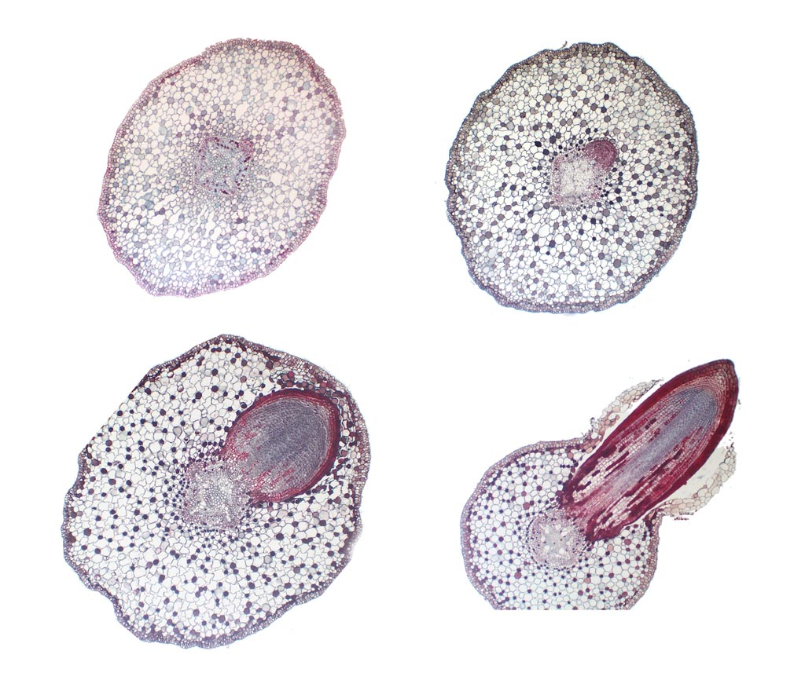
20. What tissue layer generates lateral roots?

Slide 28
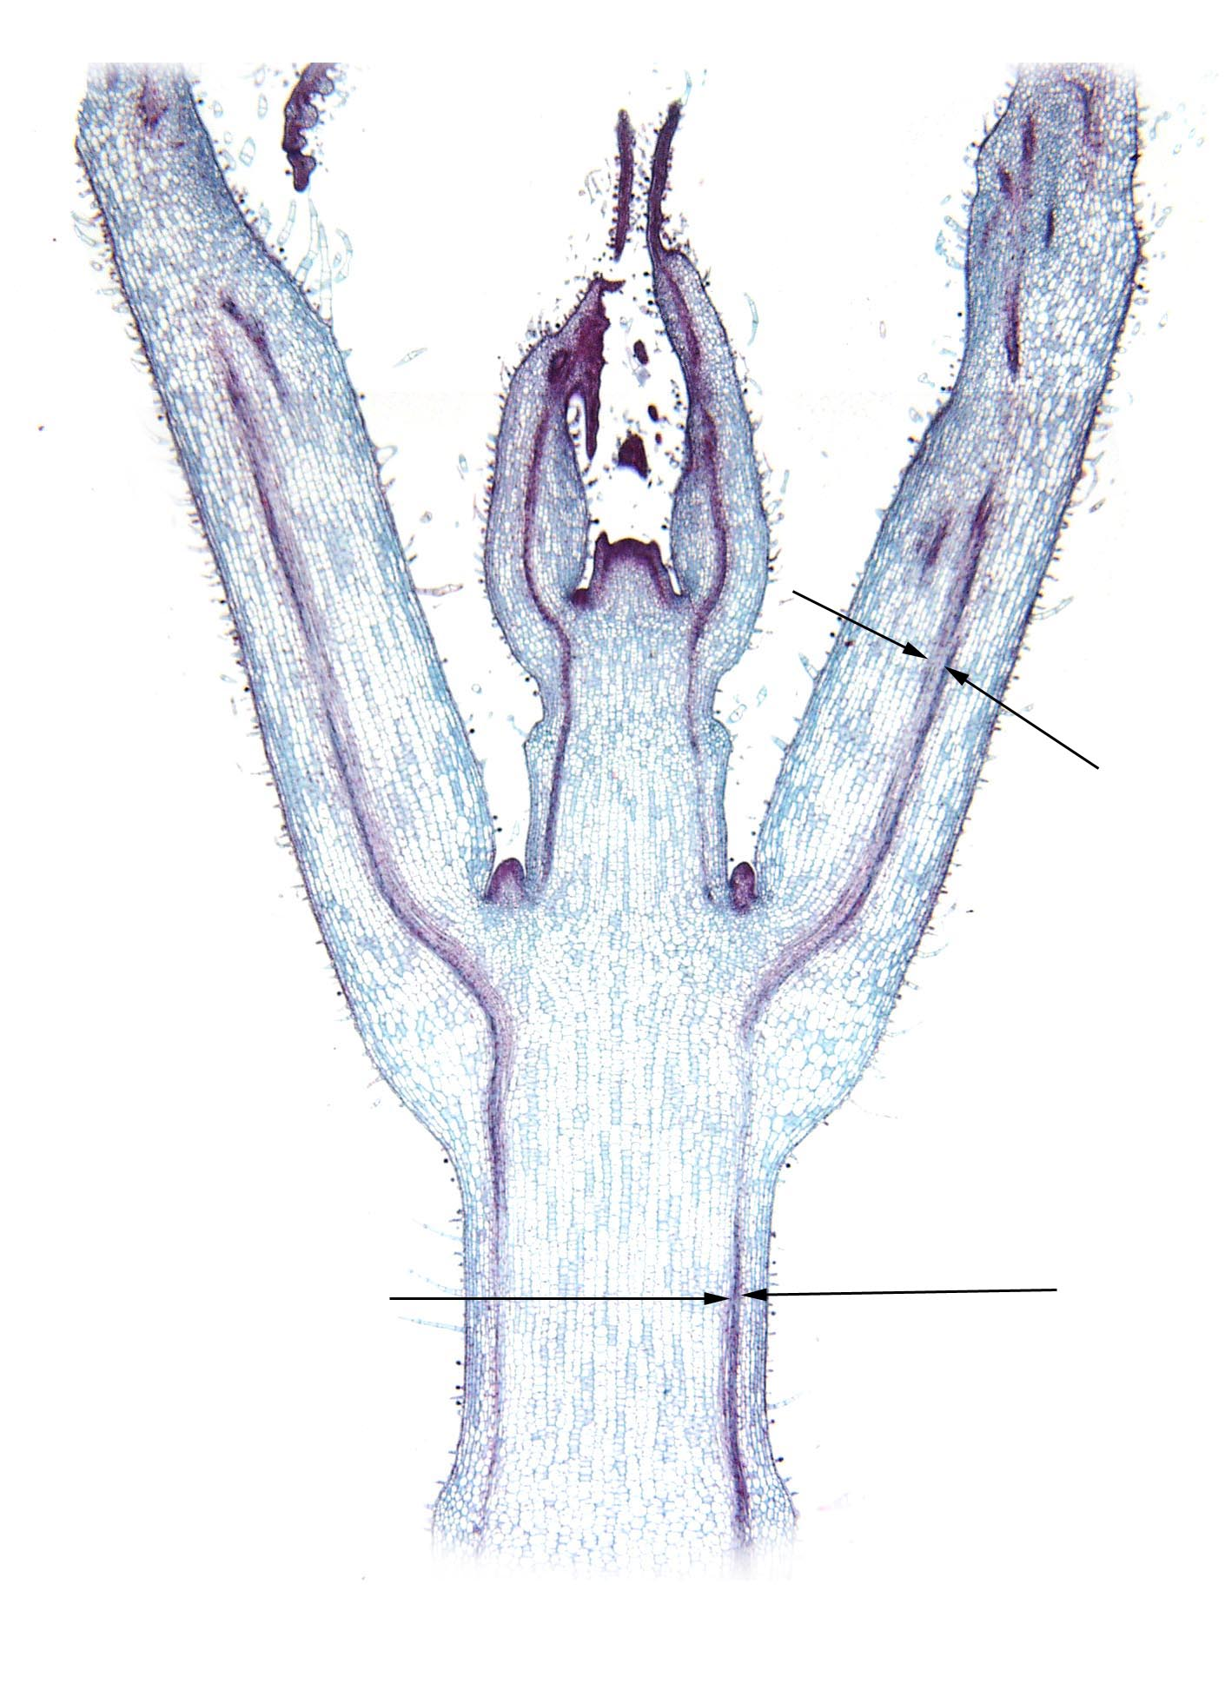
21a. Which of the three primary meristematic tissues is indicated?

Slide 29
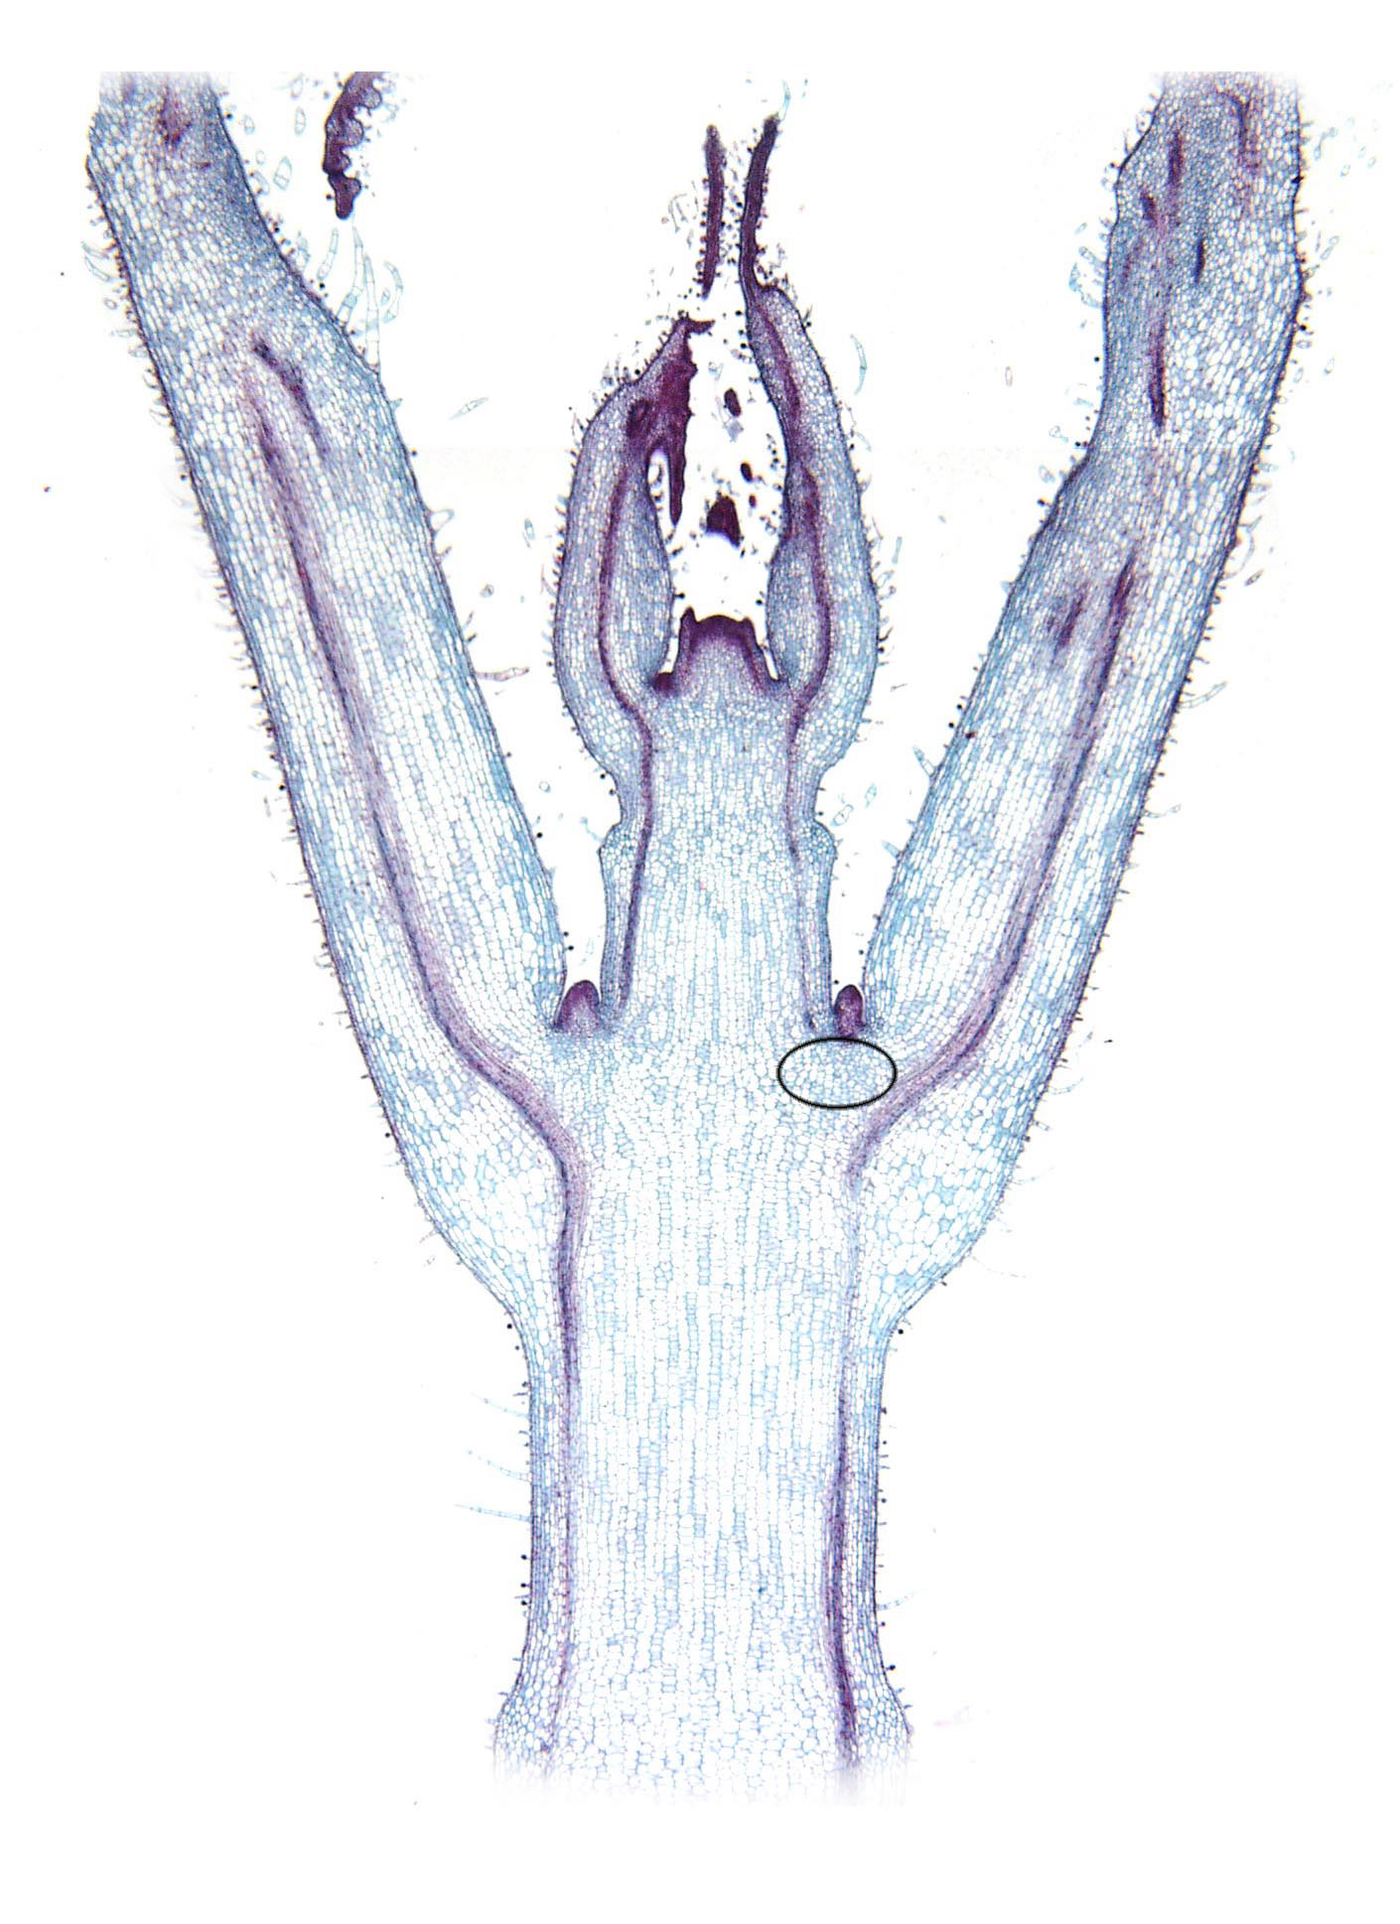
21b. What is this region of ground meristem?

Slide 30
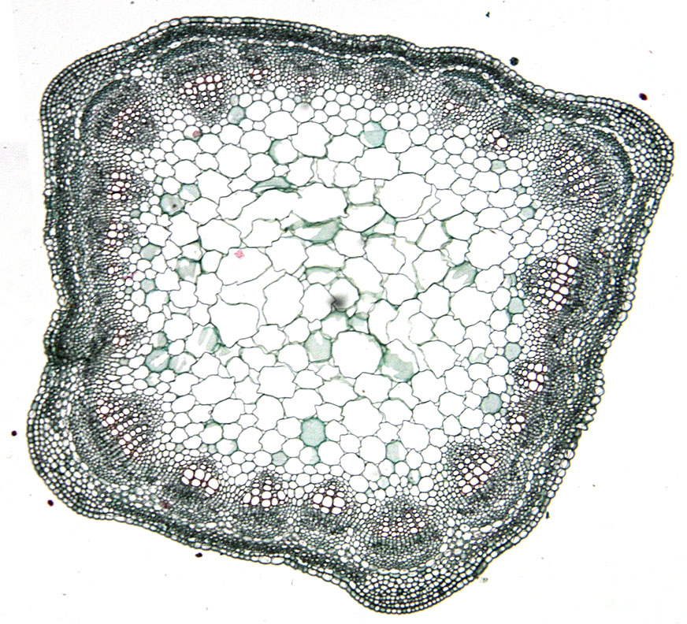
22. What is the region of the ground tissue encircled by the ring of vascular bundles?

Slide 31
23. What is the region of the ground tissue positioned outside of the ring of vascular bundles?

Slide 32
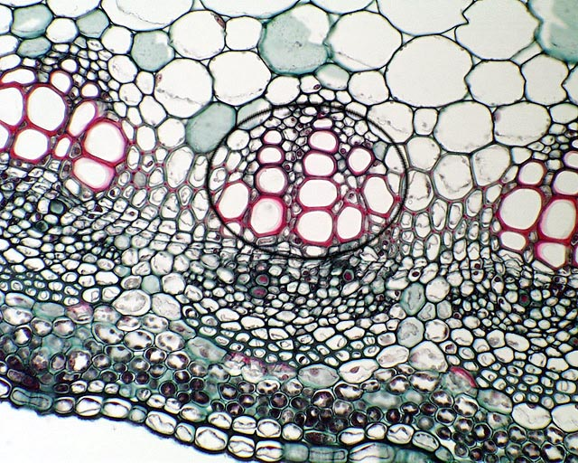
24. What is the tissue?

Slide 33
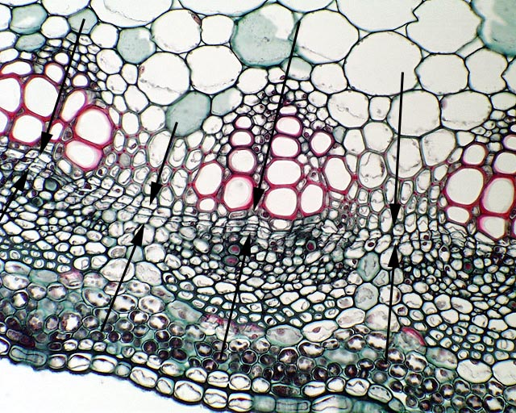
25. What is the layer of dividing cells?

Slide 34
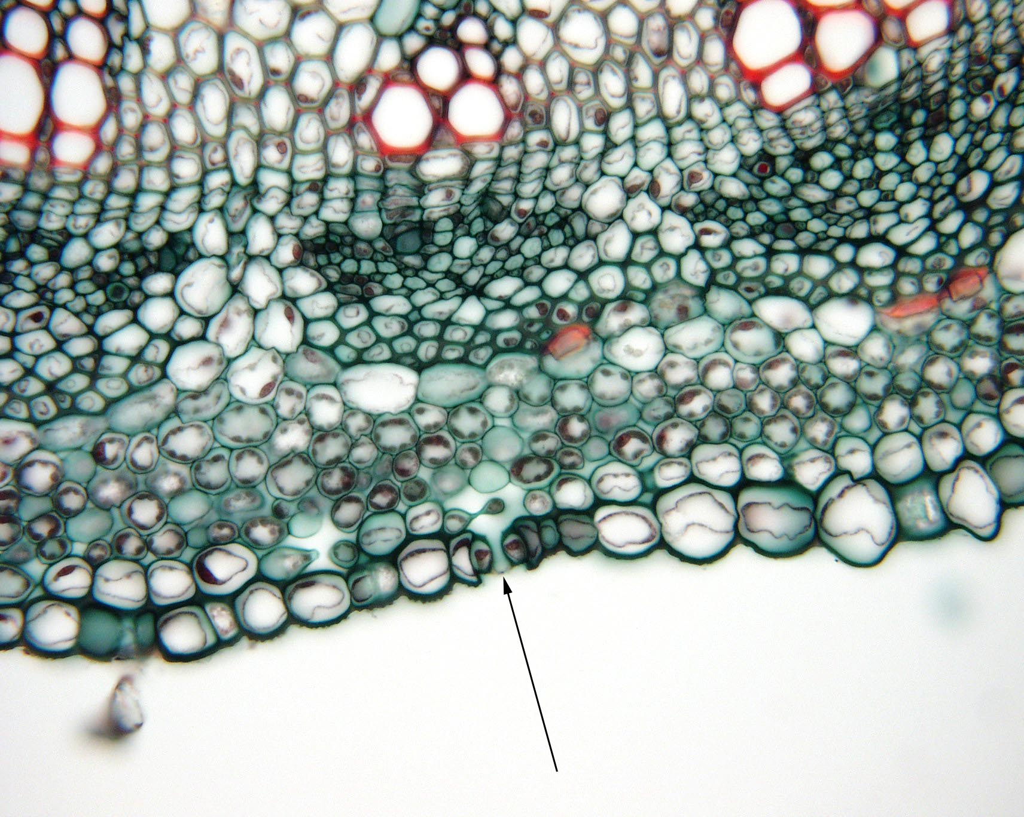
26a. What is the opening?

Slide 35
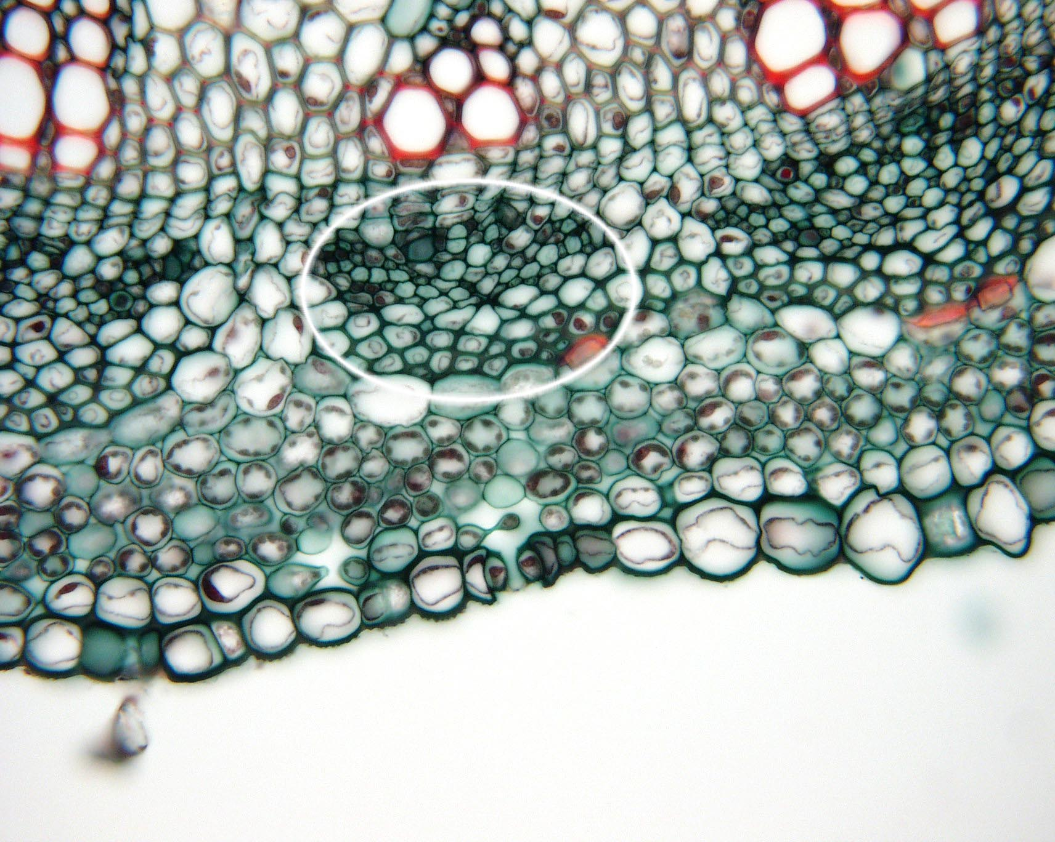
26b. What is the tissue?

Slide 36
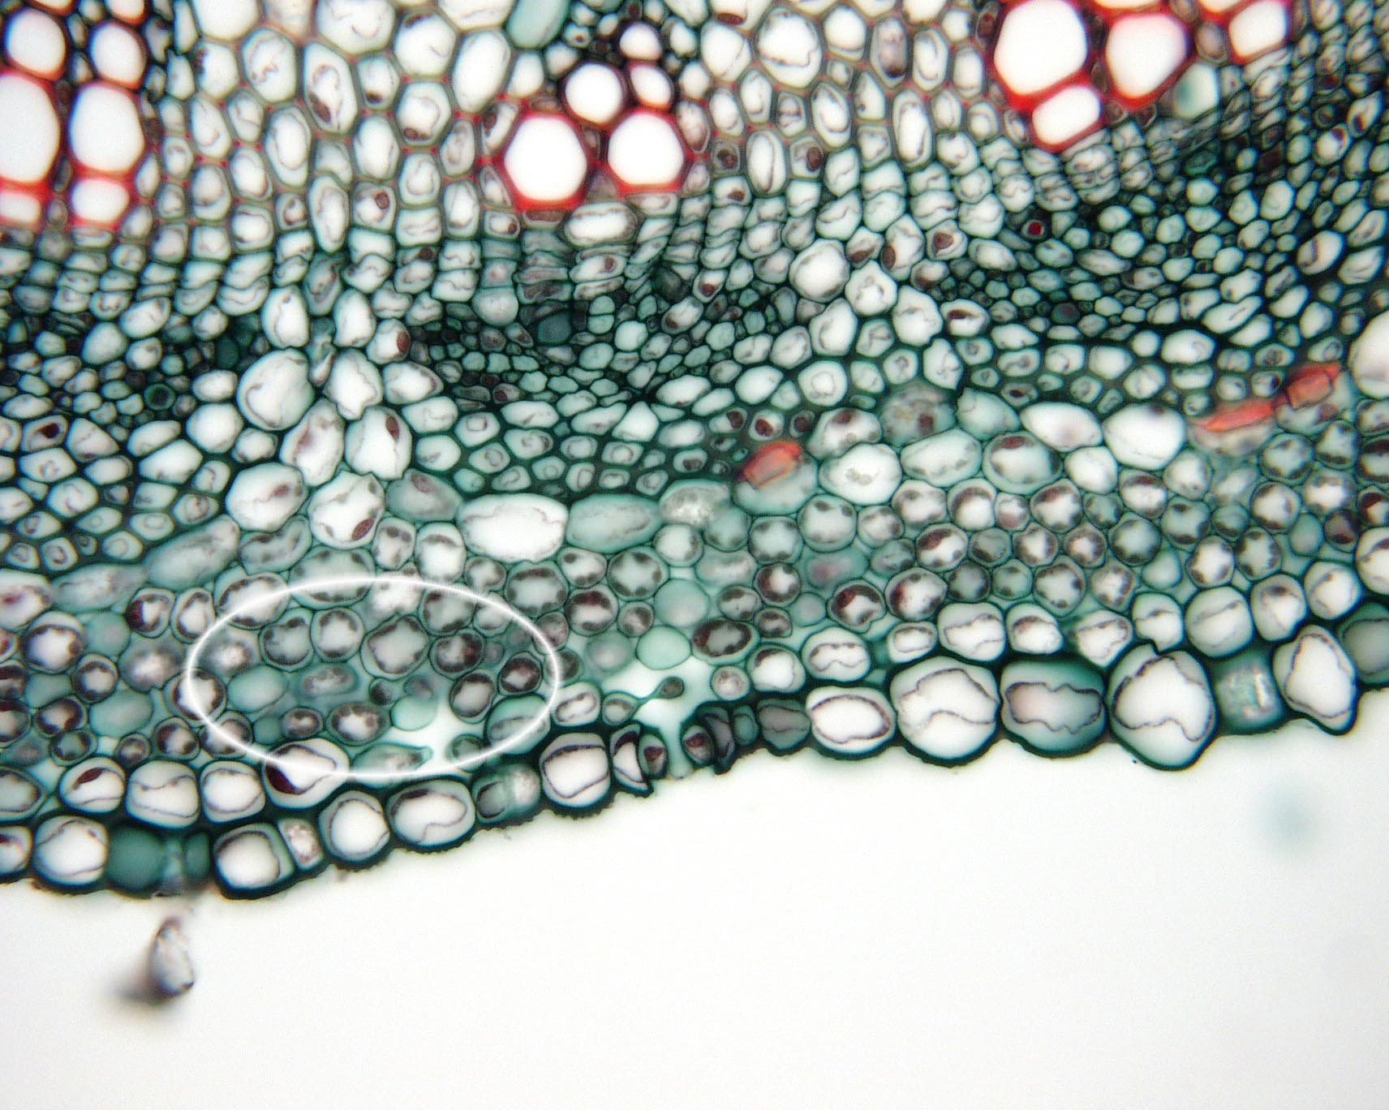
26c. What is the tissue?

Slide 37
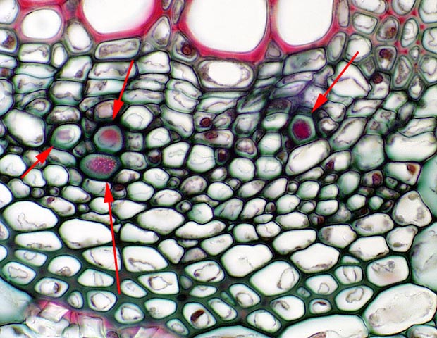
27a. What are these cells?

Slide 38
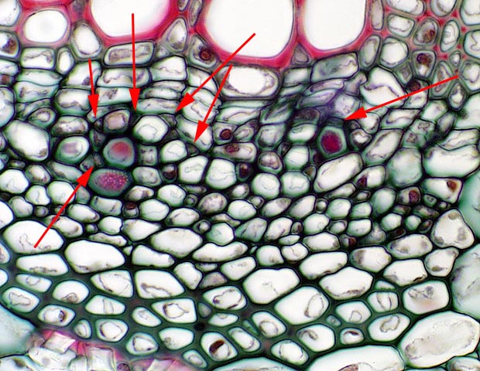
27b. What are these cells?

Slide 39
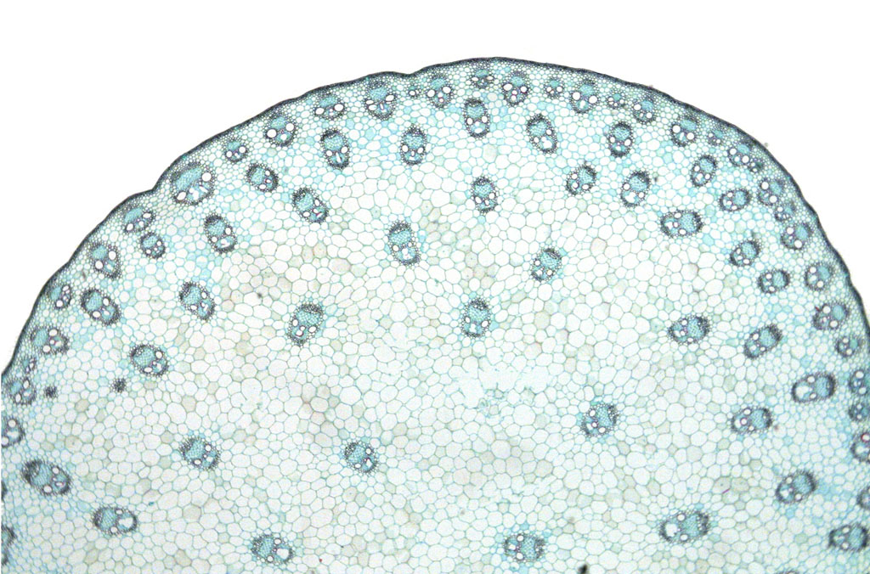
28. Is this a section through a eudicot or a monocot stem?

Slide 40
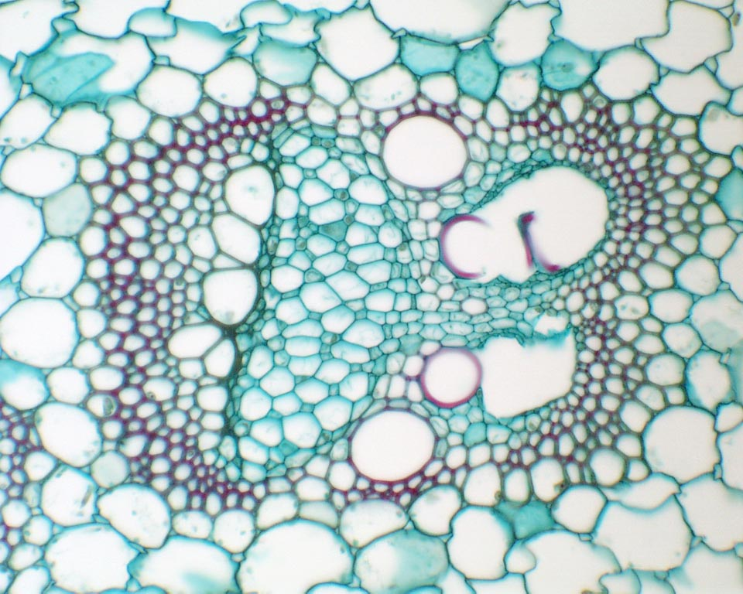
29a. What is this structure?

Slide 41
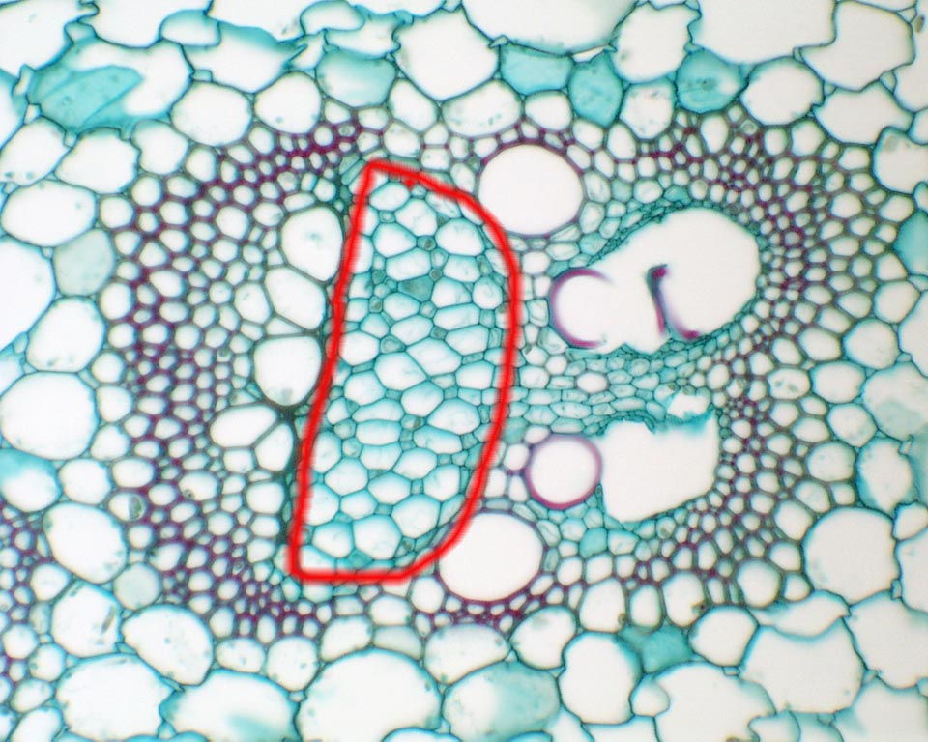
29b. What is this tissue?

Slide 42
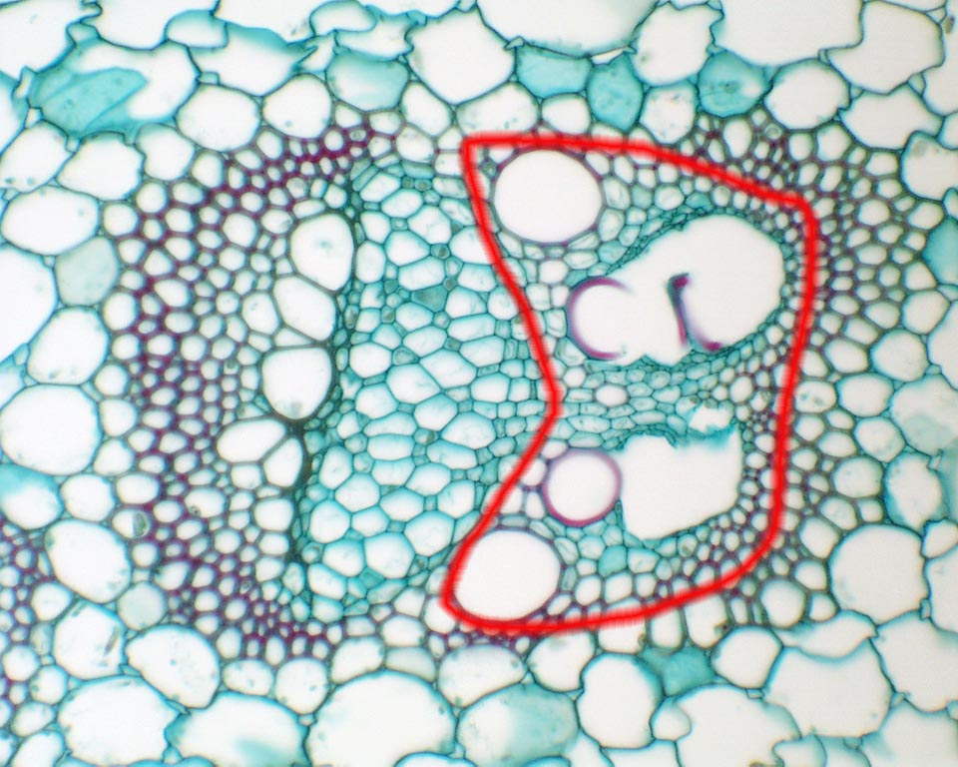
29c. What is this tissue?

Slide 43
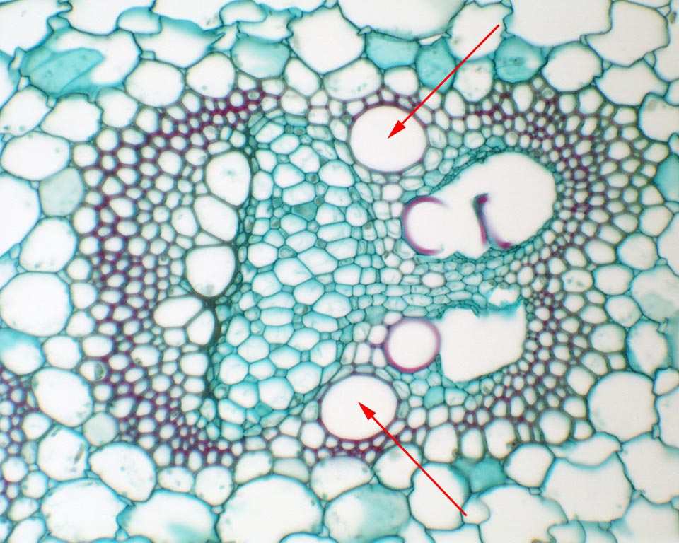
29d. What are these cells?

Slide 44
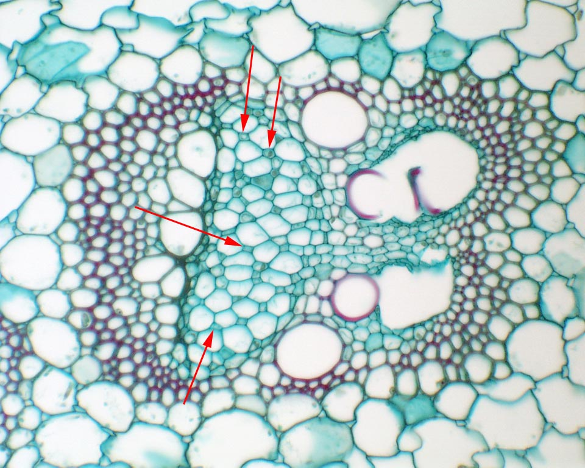
29e. What are these cells?

Slide 45
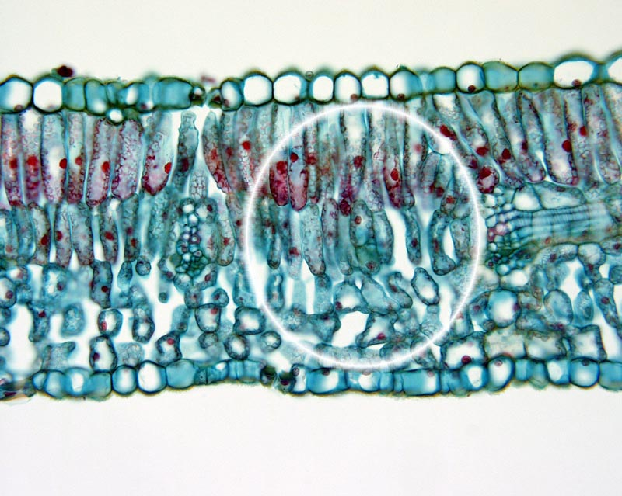
30a. What is the tissue system?

Slide 46
30b. What is the tissue type?

Slide 47
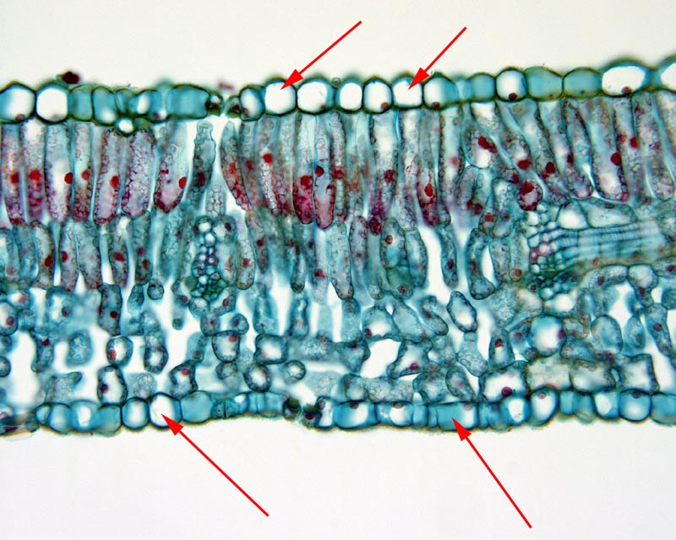
30c. What is the cell type?

Slide 48
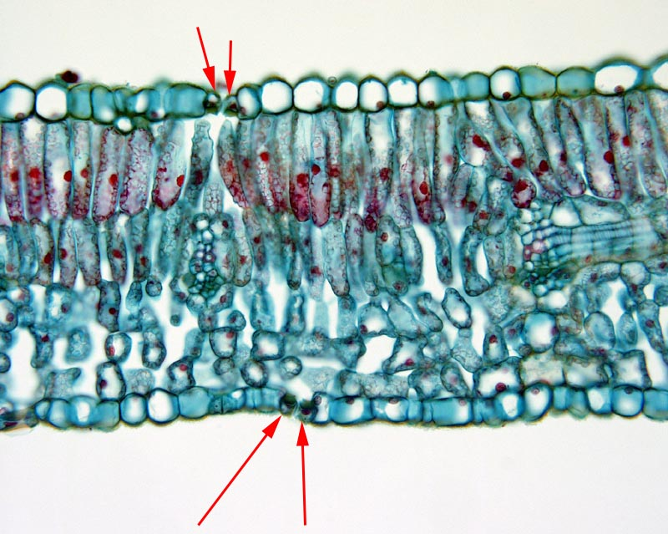
30d. What is the cell type?

Slide 49
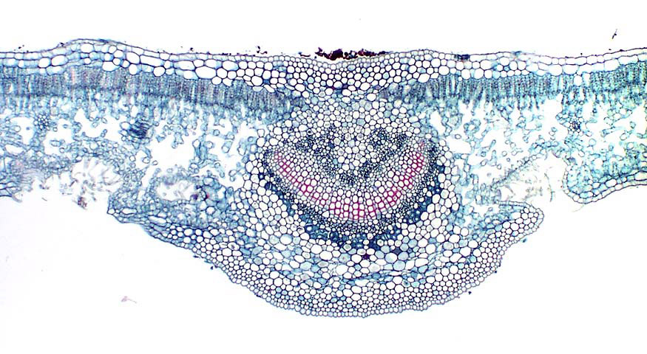
31. How is this leaf more adapted than lilac for conserving water?

Slide 50
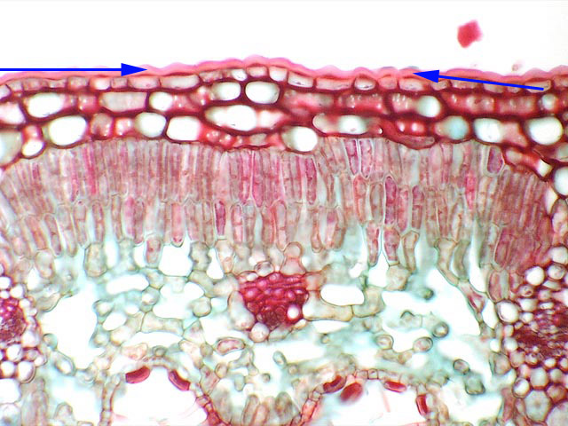
32. What is the waxy layer?

Slide 51
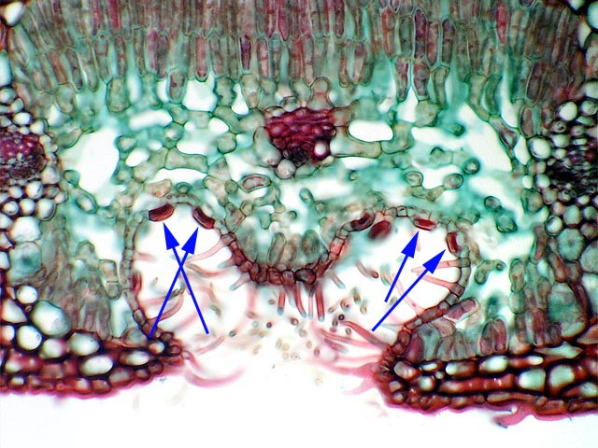
33. What are the structures?

Slide 52
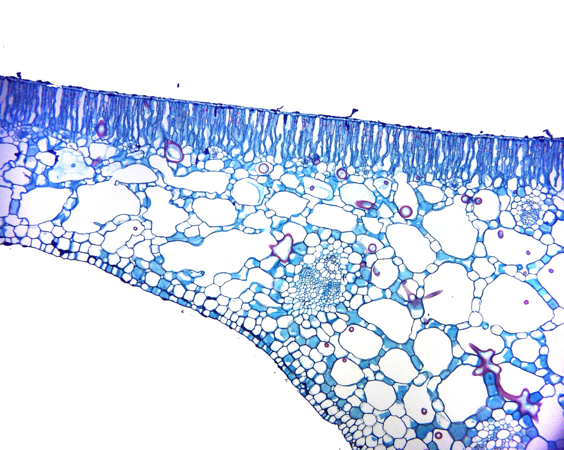
34. How is this leaf adapted for wet environments?

Slide 53
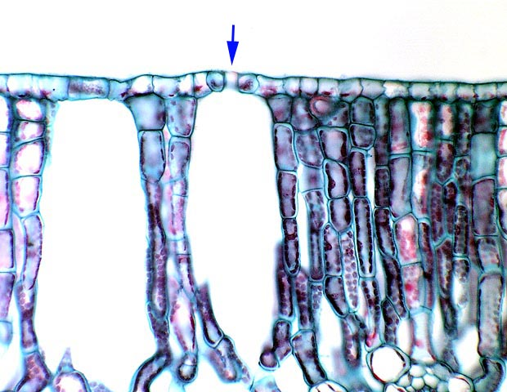
35. What is the opening?

Slide 54
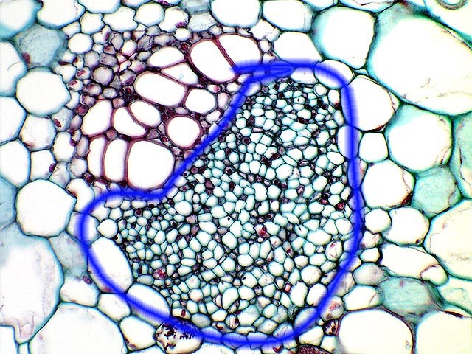
36. What is the tissue?

Slide 55
37. What is the tissue?

Slide 56
38. All these cells formed at
what location on the
shoot?

Slide 57
39. What is this layer of dividing cells?

Slide 58
40. Excluding the cells of the pith, all these cells formed at what meristem?

Slide 59
41a. What is this layer of dividing cells?

Slide 60
41b. What are these cells?

Slide 61
41c. What is this tissue layer?

Slide 62
42. What is the tissue?

Slide 63
43. What is the structure
of the periderm?

Slide 64
44. What is the function?

Slide 65
45. In what direction is the pith?

Slide 66
46a. What is this structure?

Slide 67
46b. What is this structure?

Slide 68
47a. What is this tissue layer?

Slide 69
47b. From left to right identify each of these cells.

Slide 70
48. These cells of the vascular
cambium go on to produce what
structures in the phloem and
xylem?

Slide 71
49. Everything down to what tissue layer is sloughed off at the onset of secondary growth?

Slide 72
50. What is the tissue in the center?

Slide 73
51. What is the tissue in the center?

Slide 74
52. What is this tissue of a carrot?

Slide 75
53. What are these cells of a carrot?

